Slide 1




Harman Semicon Academy Incheon 3기
Carry Lookahead Adder
소속
Harman 인천 3기 2조
박종호, 최병현, 김경래, 황혜선, 한정훈, 노성욱

Slide 2




01
프로젝트 소개
주제 선정 이유
CLA 개념
INDEX
02
설계 과정
Schematic
Layout
03
결과
Simulation
결론 및 향후 과제
01

Slide 3
Role Distribution
박종호 : 조장 & 발표 (프로젝트 전체 관리 및 발표 내용 정리)
최병현 : Block 2 Layout & Schematic (Carry-lookahead block 설계)
김경래 : PPT 제작 & Simulation (4bit, 16bit 기능 및 성능 검증 및 분석)
황혜선 : Block 1 Layout & Schematic (Adder block 설계)
한정훈 : 이론 조사 & 설계 보조 (프로젝트 과정 문서화)
노성욱 : 자료 조사 & 설계 보조 (발표 자료 준비 및 문서화)
02

Slide 4
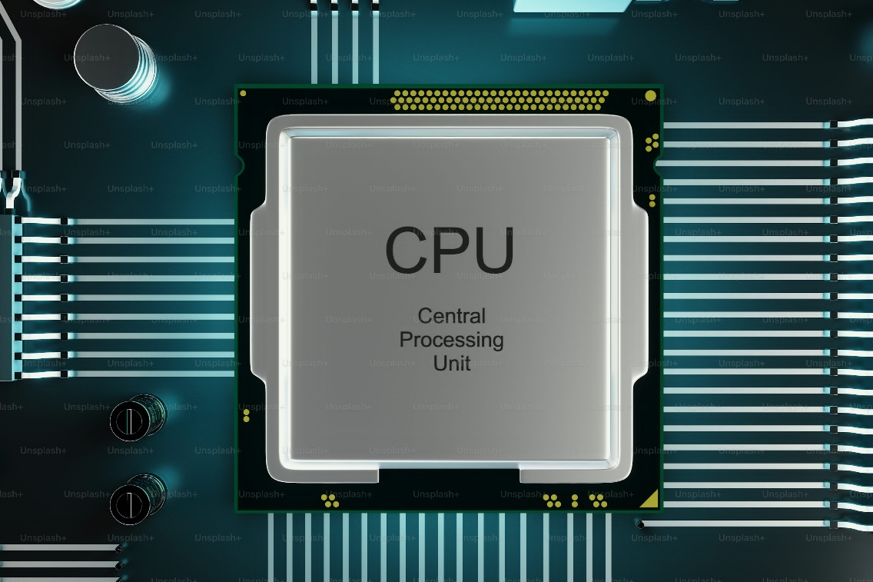
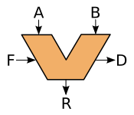
Why does CLA matters?
Critical path
03

Slide 5
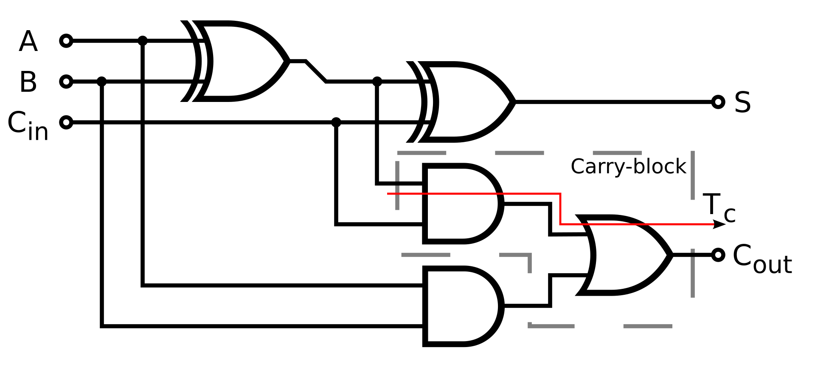
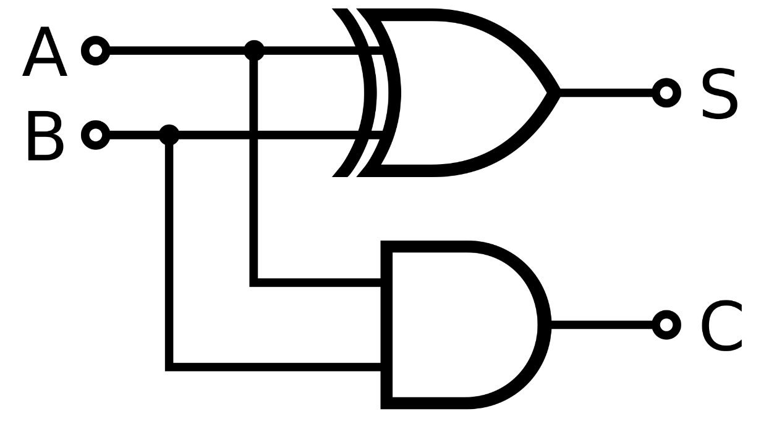
Half Adder & Full Adder
04

Slide 6


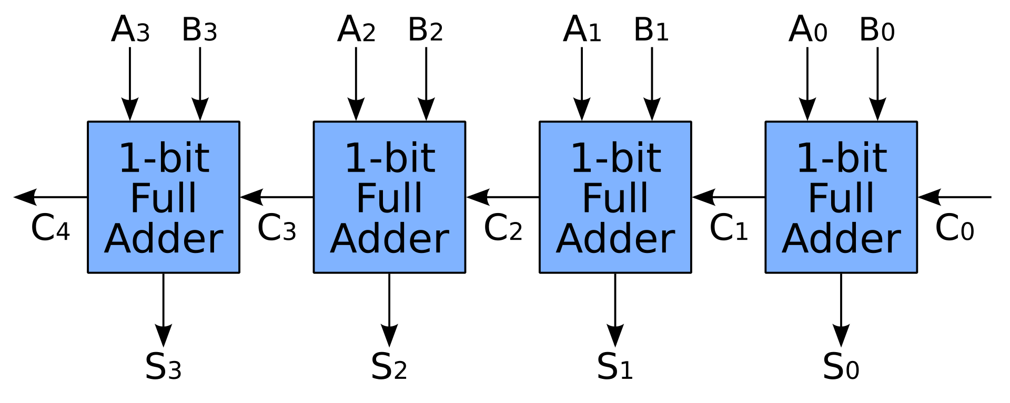
Ripple Carry Adder
RCA
Full Adder cascade structure → Delay
Simple Structure, Low Speed
Bit↑ , Delay ↑
05

Slide 7
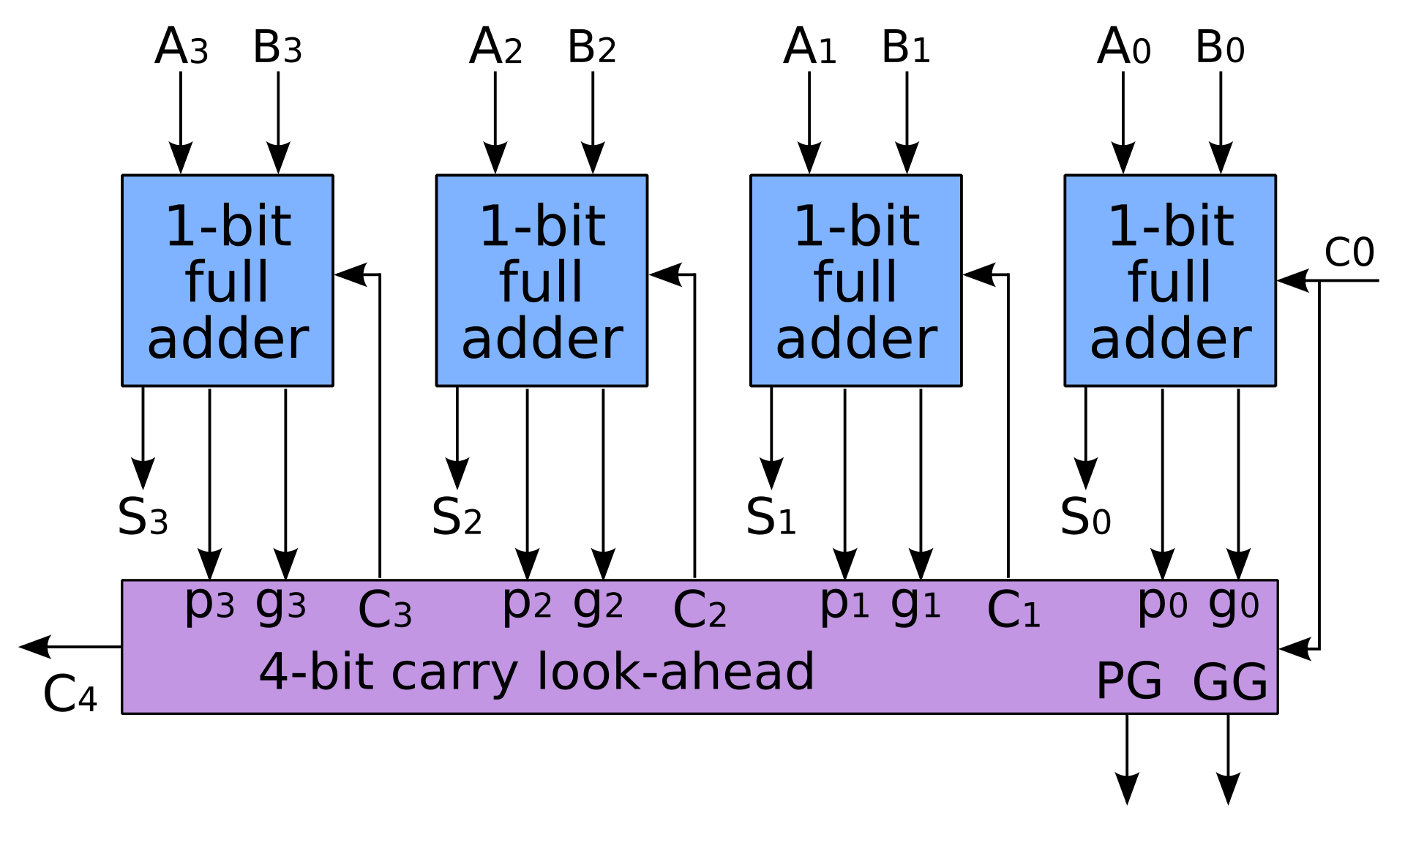
Carry Lookahead Adder
CLA
Faster than RCA
Because of Calculating each Carry, Critical path decreases
06

Slide 8
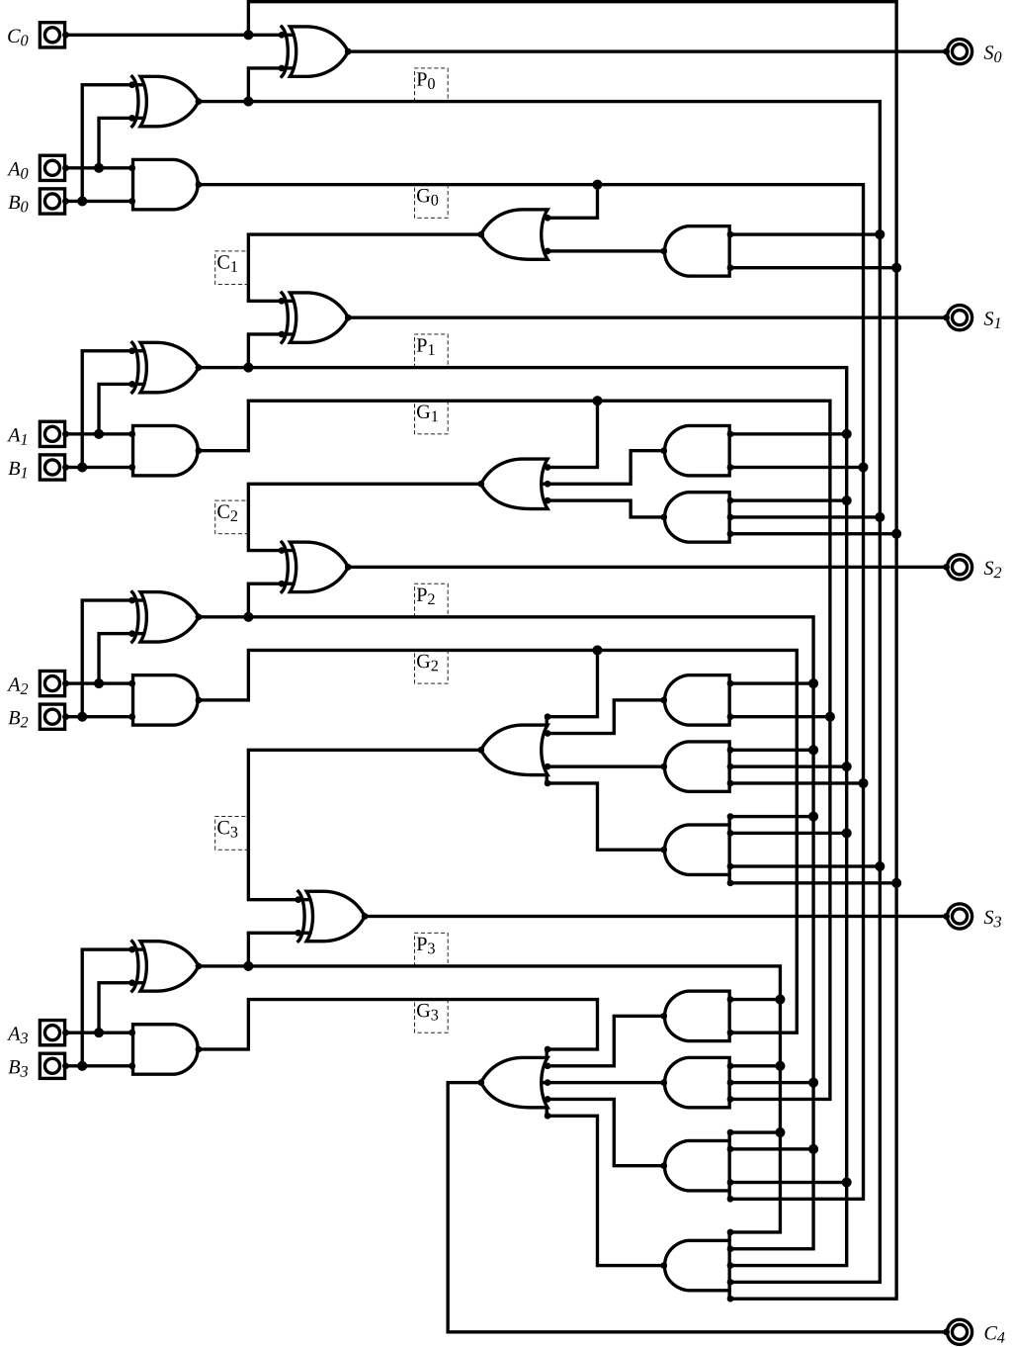
Carry Lookahead Adder
07

Slide 9
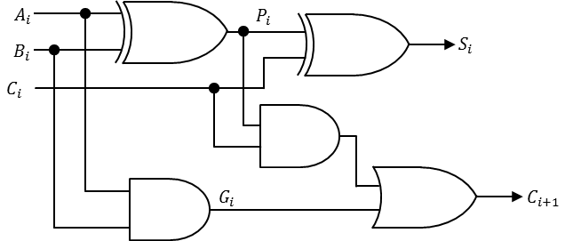
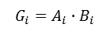
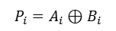
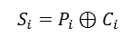
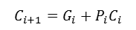
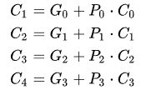
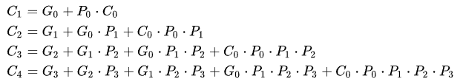
Adder Speed Analysis
08

Slide 10
Adder Speed Analysis
09

Slide 11
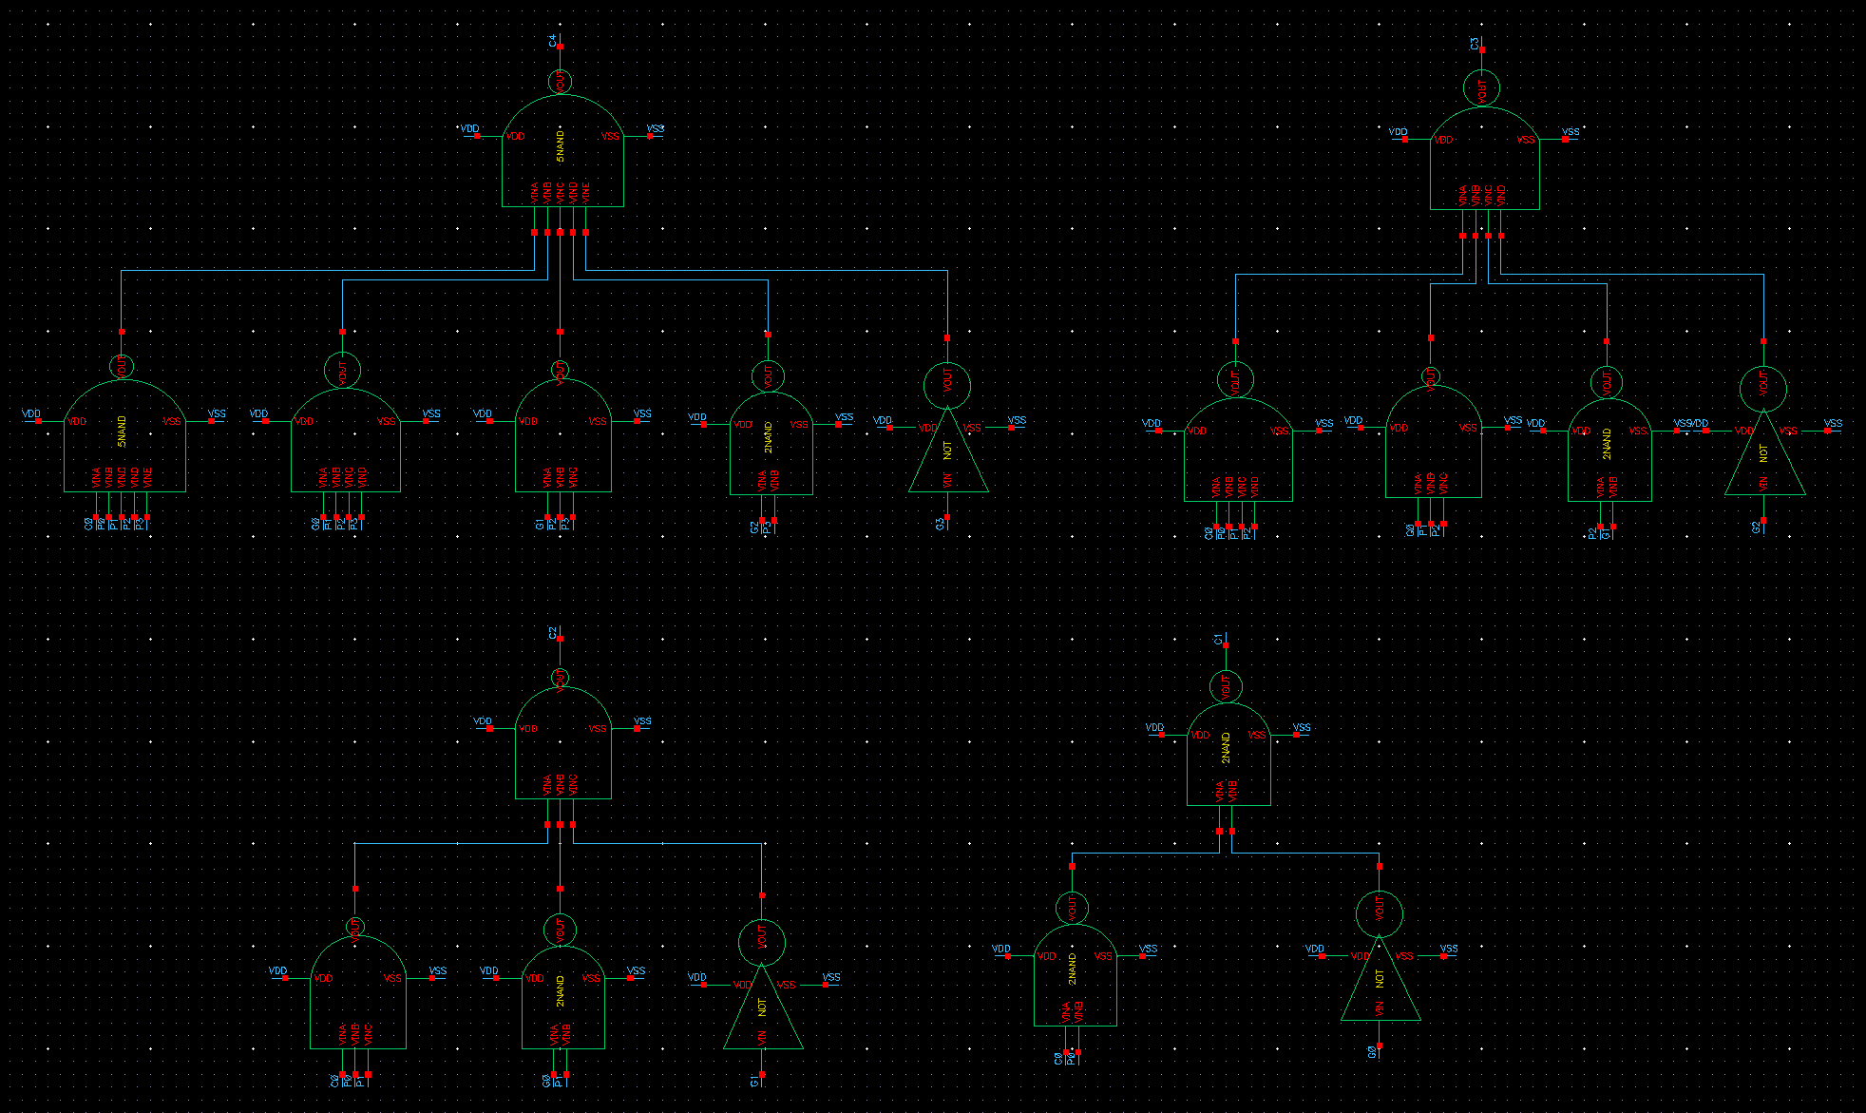
Carry Lookahead Adder
10

Slide 12
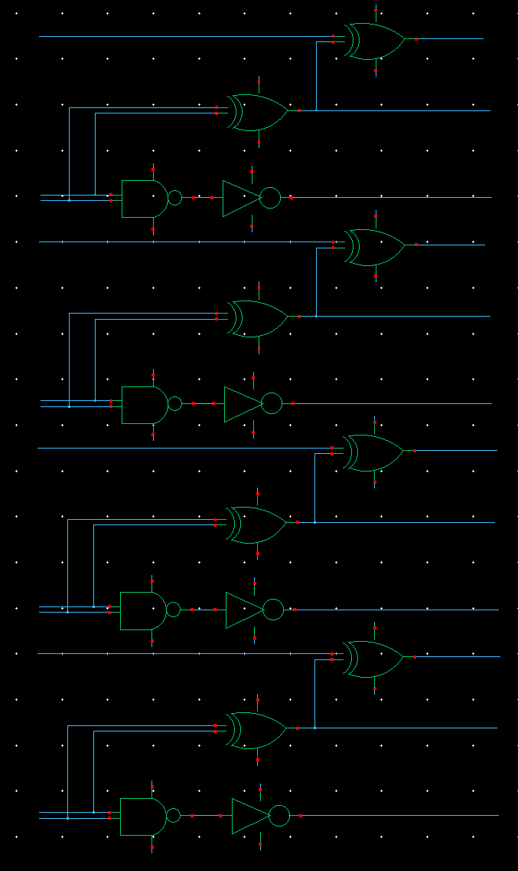
Carry Lookahead Adder
11

Slide 13
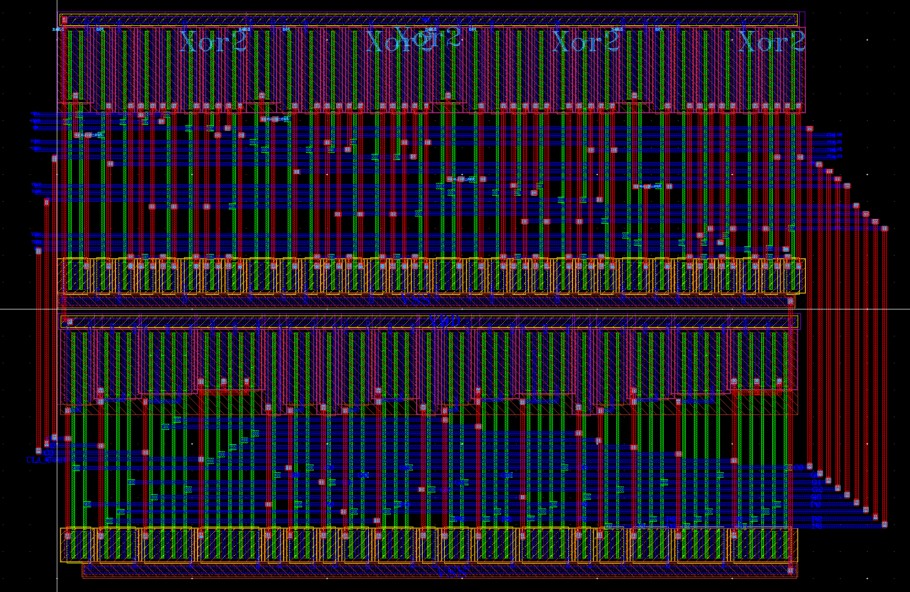
Carry Lookahead Adder
12

Slide 14
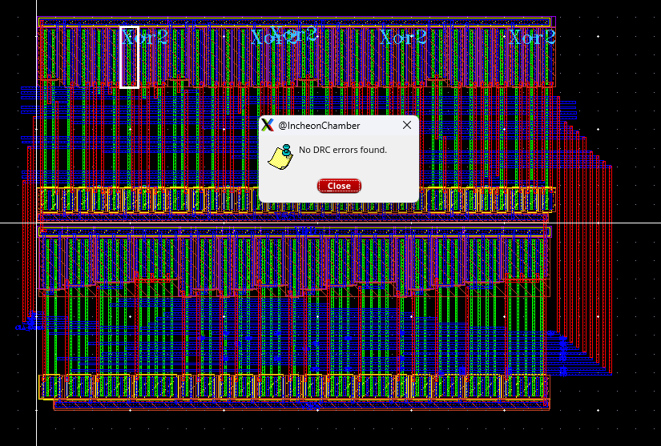
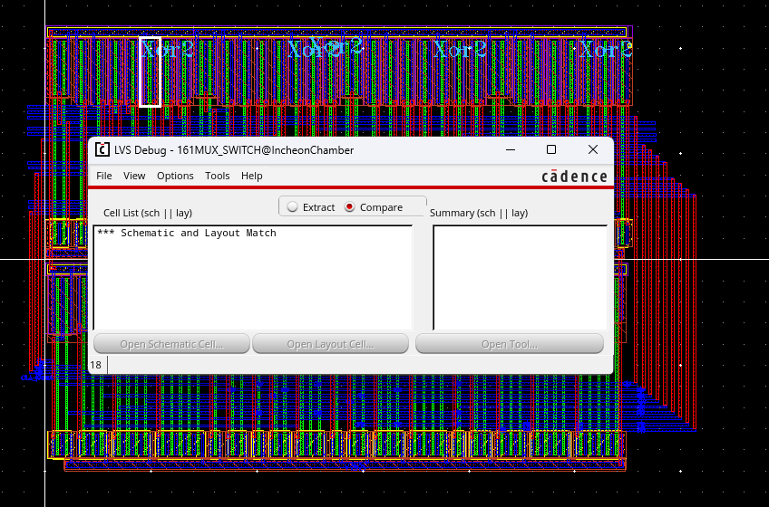
Carry Lookahead Adder
13

Slide 15
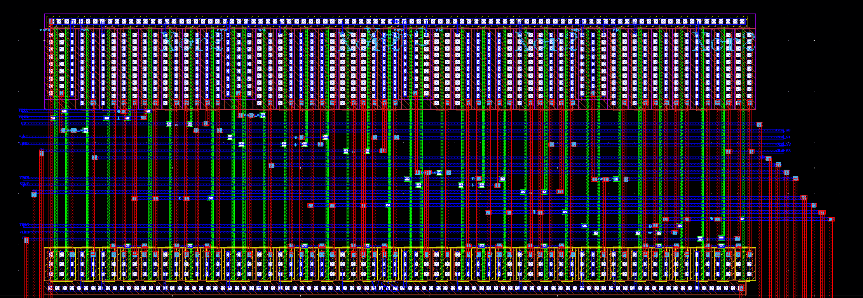
Carry Lookahead Adder
NAND
NOT
XOR
XOR
14

Slide 16
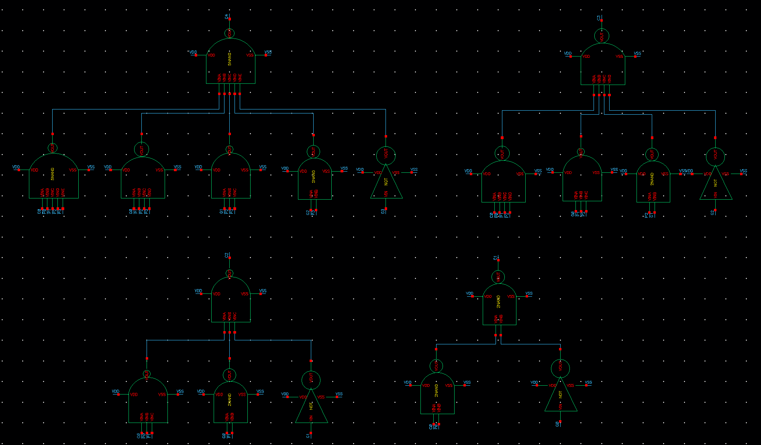
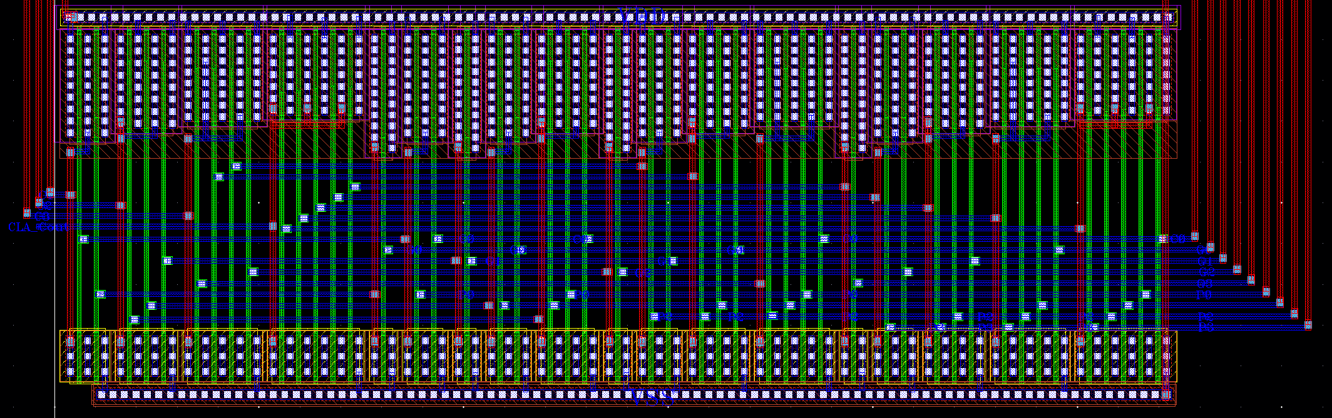
Carry Lookahead Adder
NOT
3NAND
4NAND
5NAND
2NAND
15

Slide 17
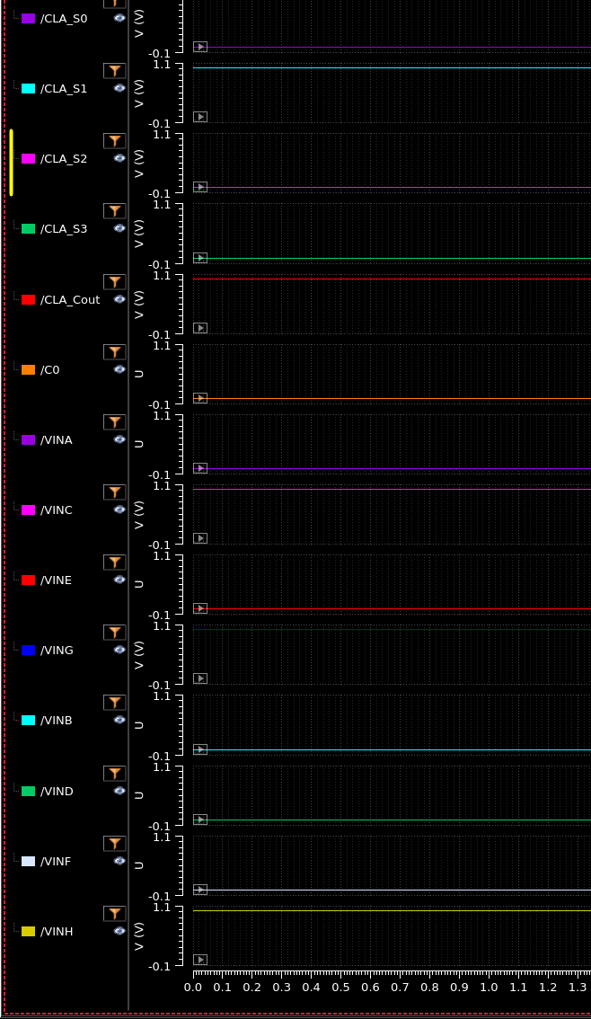
Carry Lookahead Adder
0
1
0
18
0
1
G E C A
H F D B
-----------------------------------------
C_{out} S3 S2 S1 S0
1 0 1 0
1 0 0 0
---------------------------------------
1 0 0 1 0
0
1
0
10
1
0
0
8
0
1
16

Slide 18
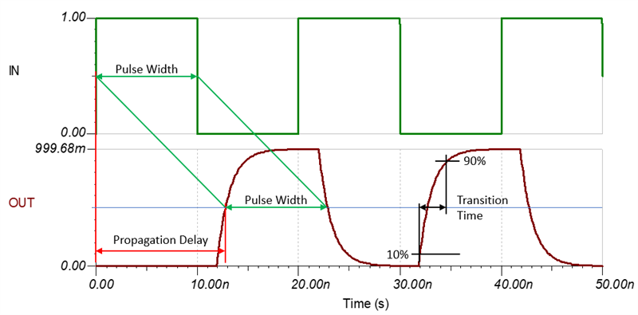
Carry Lookahead Adder
Prediction of using CLA
Propagation Delay ↓
Transition Time ↑
17

Slide 19
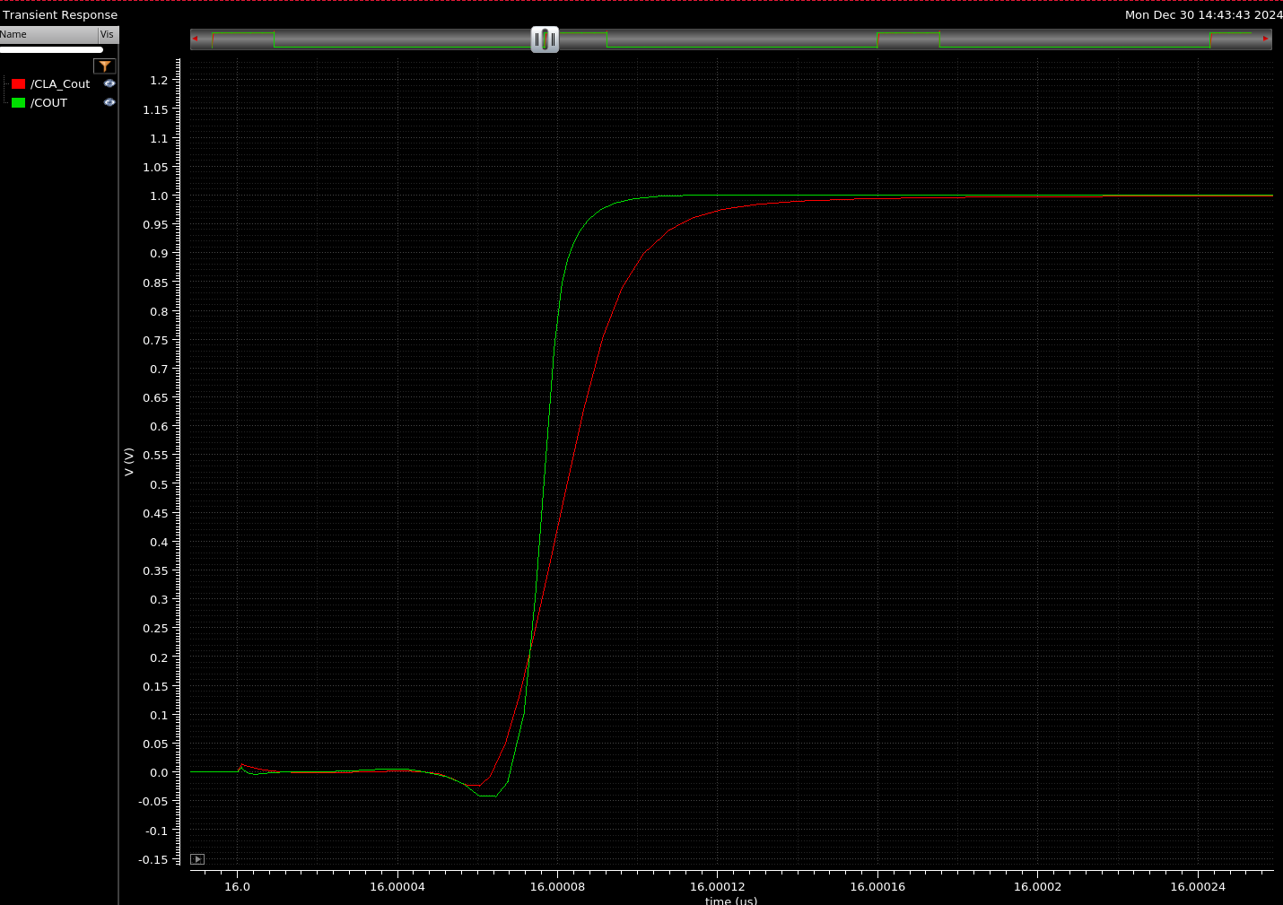
Carry Lookahead Adder
CLA & RCA 4bit Simulation Result
RCA
Path delay ↑
Transition time ↑
Response time ↓
Cause : Fanout ↑ ➔ RC Delay ↑
CLA
18

Slide 20
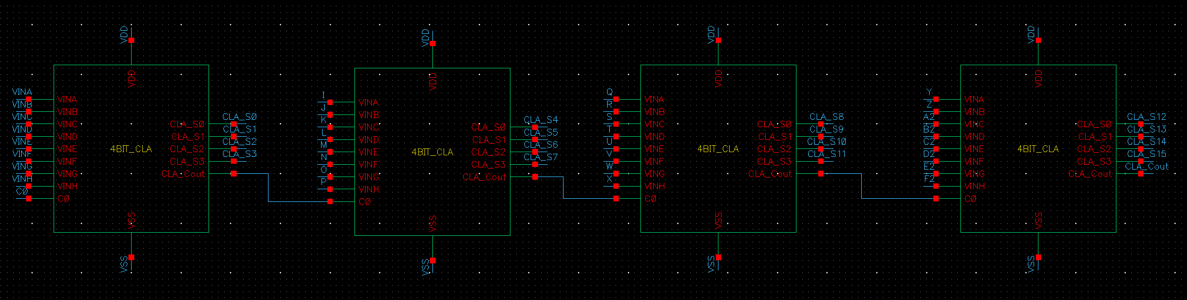
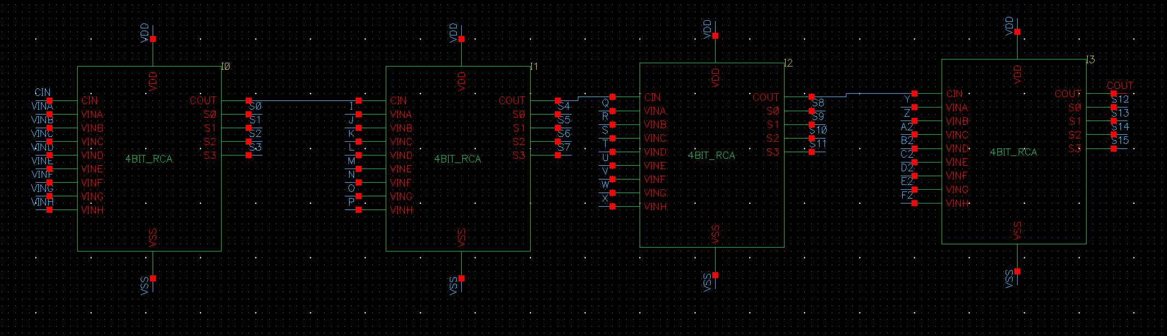
16Bit CLA & RCA Schematic
19

Slide 21
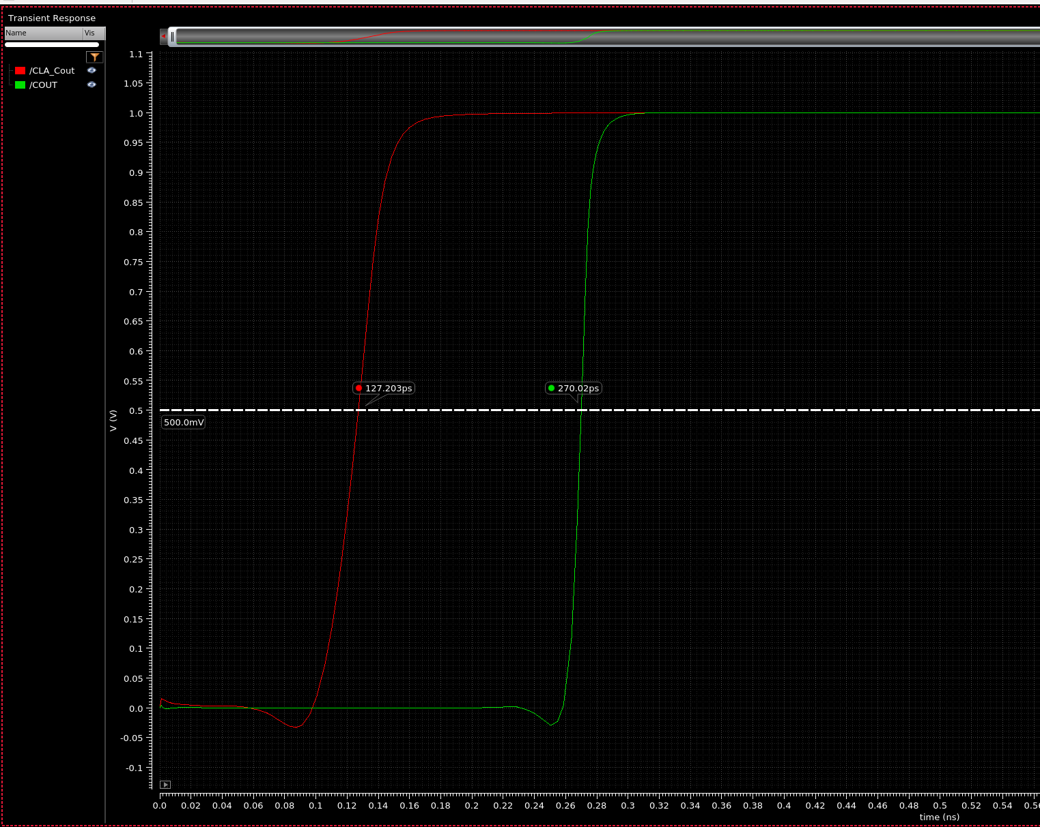
Implemented in 16bit adder
CLA & RCA 16bit Simulation Result
CLA
RCA
It matches with prediction
Propagation delay ↓
Transition time ↑
Cause : 16bit CLA complements long critical paths
20

Slide 22



CLA vs RCA
1
CLA is generally faster than RCA
Result
Delay
2
Transition time increases delay when number of bits are low
Trade off
3
Adder design requires consideration of trade off between Transition time and Propagation delay
21

Slide 23
Q & A
Thank you

